Slide 1
Capstone Project Week 1&2

Slide 2
BACKGROUND
Since mid-2016 to January 31st 2020, the British government was dealing with Brexit and the British withdrawal from the European Union had affected the housing market for both citizens and overseas buyers as the government made it more expensive for landlords and overseas buyers to purchase houses (https://www.bullionvault.com/gold-news/uk-house-prices-022420201). Especially, real estate in London comes at quite a steep price. It is this exact reason why you should not settle and find only the best fit for your needs (https://data.london.gov.uk/housing/housing-market-report/). Therefore, I am going to use the latest data for buyers to make wise and effective decisions.

Slide 3
BUSINESS PROBLEM
What is the wisest investment option for people who seek a house in London now that Brexit is finalised?
In order to recommend venues and the current average price of real estate, the neighbourhoods of London will be clustered. Recommendations of profitable venues according to amenities and essential facilities such as schools, hospitals & supermarkets will be provided.

Slide 4
DATA
Data on London properties and the relative price paid data were extracted from the HM Land Registry (http://landregistry.data.gov.uk/). If the building is divided into flats, there will be a SAON; Street; Locality; Town/City; District; County.
For data visialisation, FourSquare API interface will be used. Then the collected data from HM Land Registry and Foursquare API will be merged and show the most profitable investments in London.

Slide 5
METHODOLOGY
The Methodology of this Project:
Collection of Data
Exploring and Understanding Data
Data Preparation and Preprocessing
Modelling

Slide 6
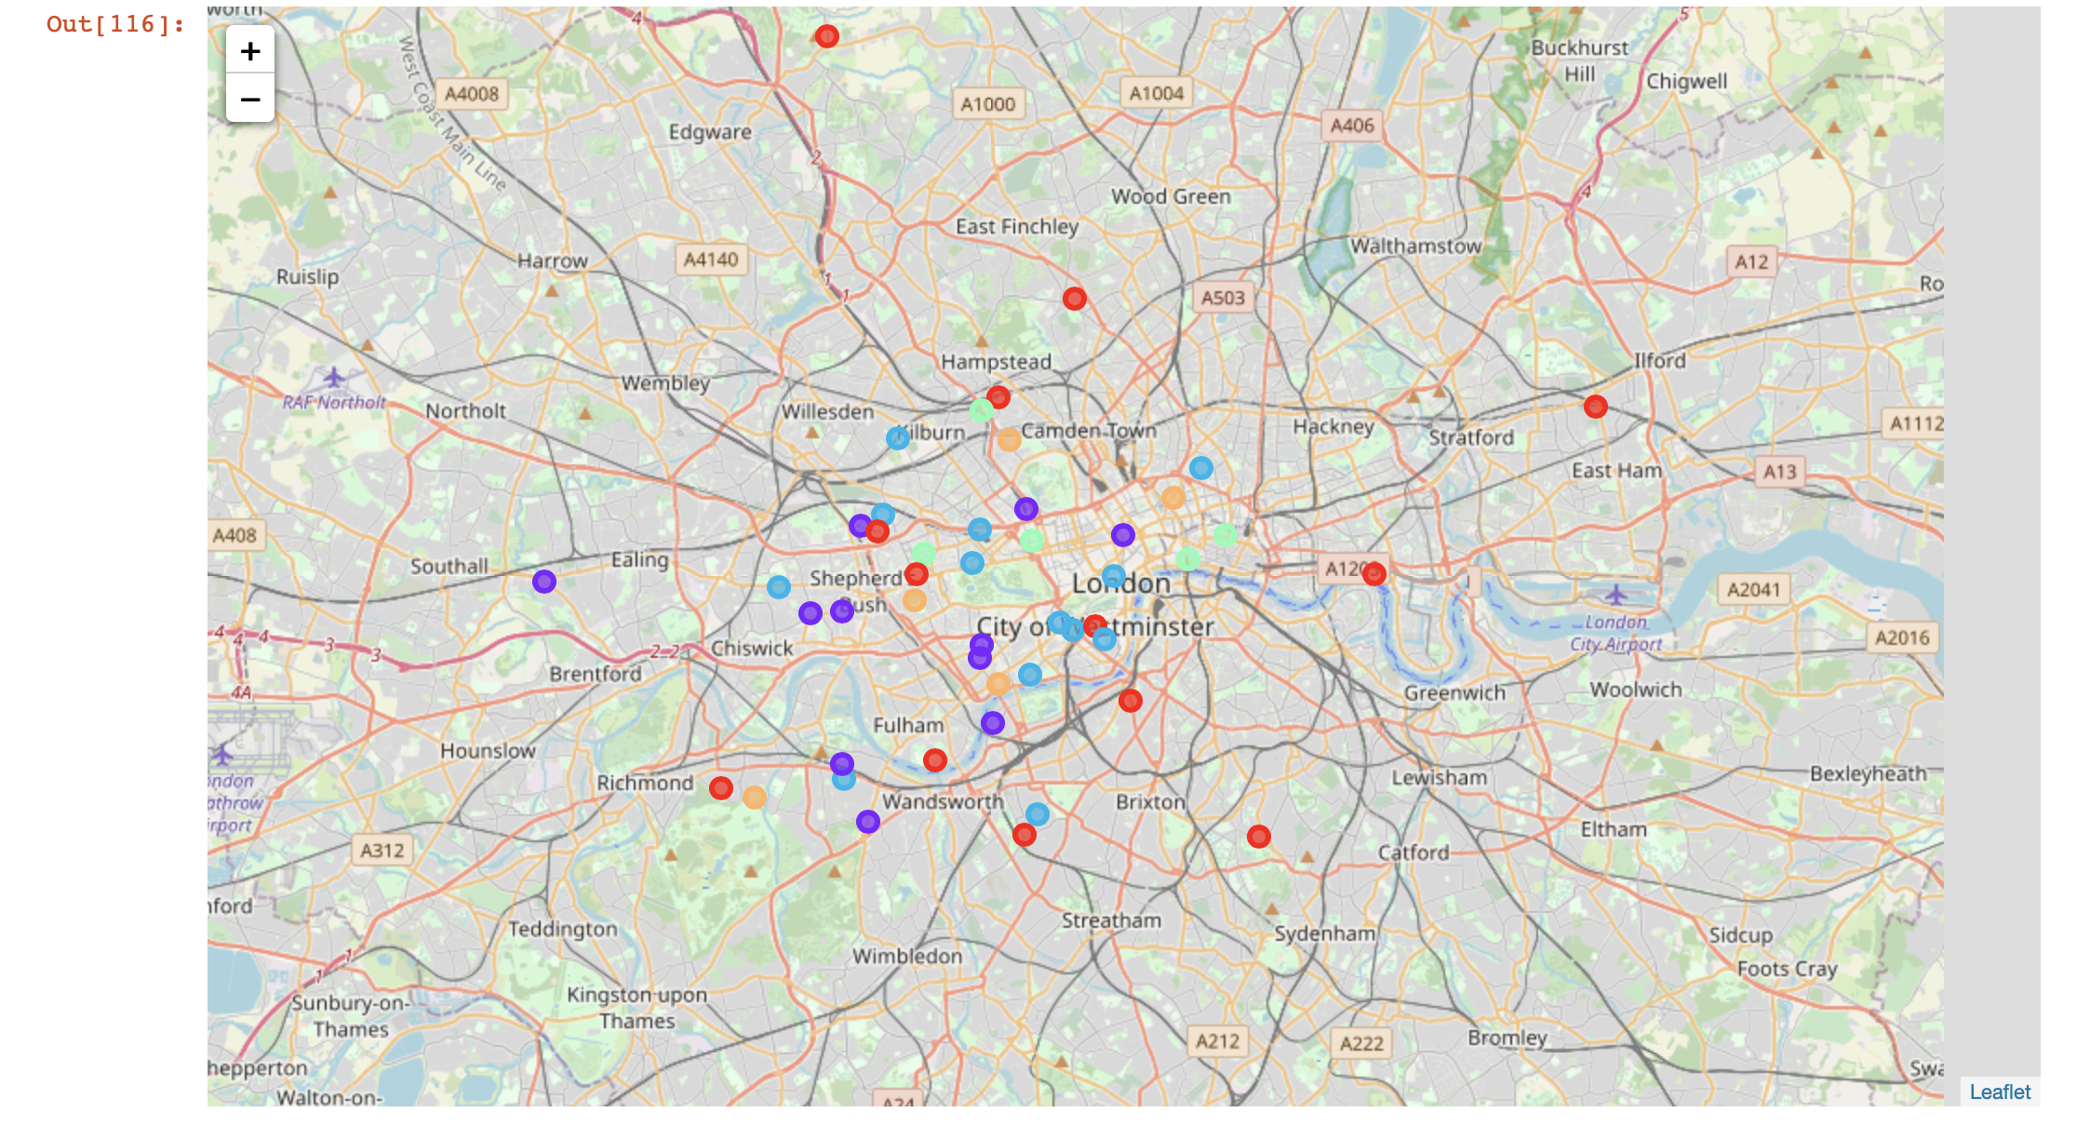
RESULTS AND DISCUSSION
Even though, the UK has left the European Union it is still a place that both citizens and non-citizens would like to invest especially in London.

Slide 7
RESULTS AND DISCUSSION
First of all, West London (Kensington, Chelsea, Marylebone areas) and North-West London (Camden Town, Hampstead areas) were expected to pop as a profitable investment due to the wide range of amenities and essential facilities and venues. Yet South-West London (Brixton and Wandsworth, areas) and also Limehouse in East London are also arising as next future venues with a wide range of amenities and facilities. Therefore, South-West London and Limehouse could be a good investment opportunity for those who do not wish to invest in luxurious neighbourhoods like Kensington.
Secondly, by using the clusters the results can be analysed. In a city like London, there will be lots of pubs and restaurants but the clusters show different patterns. As you can see, the 3rd and 4th clusters tell us that those areas are more for people who are more active as it has an harbour, golf course, dance studios and fitness centres. The clusters 0, 1 and 2 can be interesting for investors who love going to pubs cafes and restaurants.

Slide 8
CONCLUSION
The UK withdrawal from the European Union had affected the British housing market both for the citizens and non-citizen buyers as the government made it more expensive for landlords and overseas buyers to purchase houses. Especially, real estate in London comes at quite a steep price. Therefore I tried to find the wisest investment options for people who seek a house in London now that Brexit is finalised. Recommendations of profitable venues according to amenities and essential facilities such as schools, hospitals & supermarkets was also a part of this project.
Data on London properties and the relative price paid data were extracted from the HM Land Registry. For data visualisation, FourSquare API interface is used. Then the collected data from HM Land Registry and Foursquare API is merged and showed the most profitable investments in London.
The Methodology for this project will start with 1. Collection of Data then continue with 2. Exploring and Understanding Data, 3. Data Preparation and Preprocessing and 4. Modelling. I will use the k-means clustering technique will be used for this project as it is accurate, efficient and highly flexible.

Slide 9
CONCLUSION
In conclusion, even though, the UK has left the European Union London is still a place that both people would like to invest. Although West London and North-West London were expected to pop as a profitable investment due to the wide range of amenities and essential facilitiesand venues. Yet South-West London (Brixton and Wandsworth, areas) and also Limehouse in East London are also arising as next future venues with a wide range of amenities and facilities. Therefore, South-West London and Limehouse could be a good investment opportunity for those who do not wish to invest in luxurious neighbourhoods like Kensington.
Secondly, by using the clusters the results can be analysed. In a city like London, there will be lots of pubs and restaurants but the clusters show different patterns. As you can see, the 3rd and 4th clusters tell us that those areas are more for people who are more active as it has an harbour, golf course, dance studios and fitness centres. The clusters 0, 1 and 2 can be interesting for investors who love going to pubs cafes and restaurants.

Slide 10
Thank you Zeynep Bökeer

